Slide 1

CPU Scheduling and Optimization
By: Nivedita Prabhu, Joy Omaji, Shravani Kardekar, and Yash Nikumb

Slide 2
Team L About Me
Nivedita Prabhu
Joy Omaji
Shravani Kardekar
Yash Nikumb
Major in Computer Science, Minor in Mathematics
Major in Computer Science,
Minor in Mathematics, Data Analytics
Major in Computer Science,
Minor in Mathematics
Major in Computer Science
Minor in Mathematics

Slide 3
TABLE OF CONTENTS
Introduction
CPU Overview
01
03
Comparison of Algorithms
Conclusion
02
04

Slide 4
INTRODUCTION
CPU scheduling is a critical function of Operating systems, deciding which process gets the CPU and when. It directly affects system efficiency, responsiveness and overall performance
We will compare the four major CPU scheduling algorithms:
First Come First Serve
Shortest Job First(SJF)
Round Robin(RR)
Priority Scheduling
We will also evaluate their Average Waiting Time, Turnaround time and Completion Time.
Our goal is to understand which algorithms perform the best under different system goals like fairness, Efficiency and Responsiveness.

Slide 5
CPU Scheduling Overview
CPU scheduling algorithms determine the order in which processes access the CPU, directly impacting system efficiency and responsiveness.
FCFS (First Come First Served): Simple, non-preemptive, but poor for short jobs.
SJF (Shortest Job First): Minimizes waiting time; may cause starvation.
Round Robin: Fair, time-sliced; good for responsiveness, high context switching.
Priority Scheduling: Executes based on priority; risks starvation of low-priority jobs.
Choosing the right scheduling strategy depends on system goals—whether optimizing for speed, fairness, or efficient resource use.

Slide 6
CPU Scheduling Optimization Overview
Optimization in CPU Scheduling focuses on balancing performance metrics (eg. waiting time, throughput and fairness). Here's how we can optimize our 4 scheduling methods:
Round Robin: We focus on reducing wait time, turnaround time and context switches. This is achieved by dynamic time quantum or hybrid approaches.
FCFS (first come first serve): This is a baseline algorithm =, therefore it can only be used for basic batches and used in comparisons.
SJF (Shortest Job First): We focus on minimizing wait time and turnaround time. The challenges we try to overcome are starvation and burst time prediction.
Priority Scheduling: The objective is to efficiently handle high-priority tasks and reduce starvation of low-priority tasks.
Modern scheduling trends favor adaptive, hybrid approaches to meet complex system demands.

Slide 7
Algorithms
Round Robin
First Come, First Serve
01
02
Each process gets a small unit of CPU time. After time as elapsed, the process is preempted and added to the end of the ready queue
The process that requests the CPU first is allocated the CPU first
Priority Scheduling
Shortest Job First
03
04
The CPU is allocated to the process with the highest priority
Associate with each process the length of its next CPU burst

Slide 8
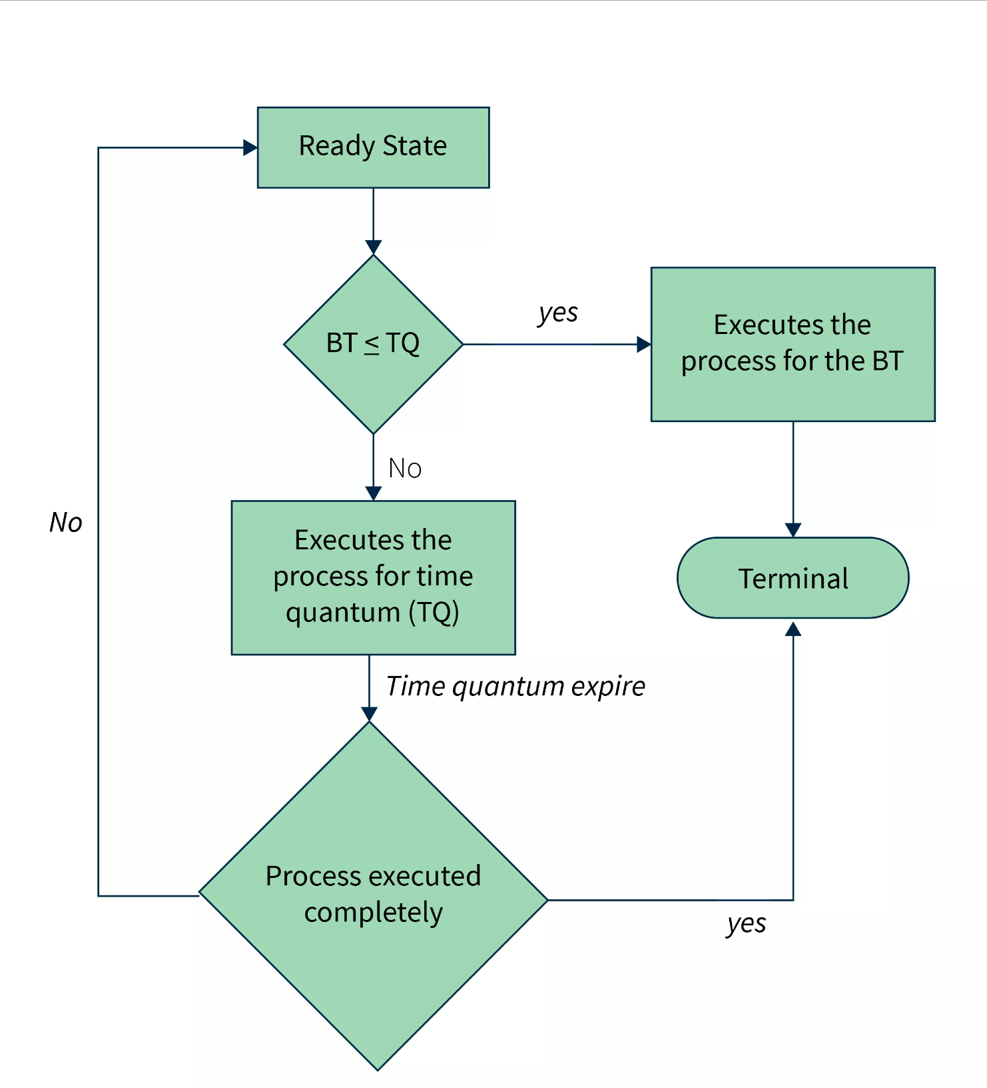
Round Robin
Round Robin is a preemptive version of FCFS (First-Come, First Serve) where each process stays in the ready state for a fixed time (time quantum).
Every process gets cyclically, meaning that their remaining burst time is sent back to the ready state until the next turn and termination.
If BT ≤ TQ, then it goes back to Ready State
If BT ≥ TQ, then it termination.

Slide 9
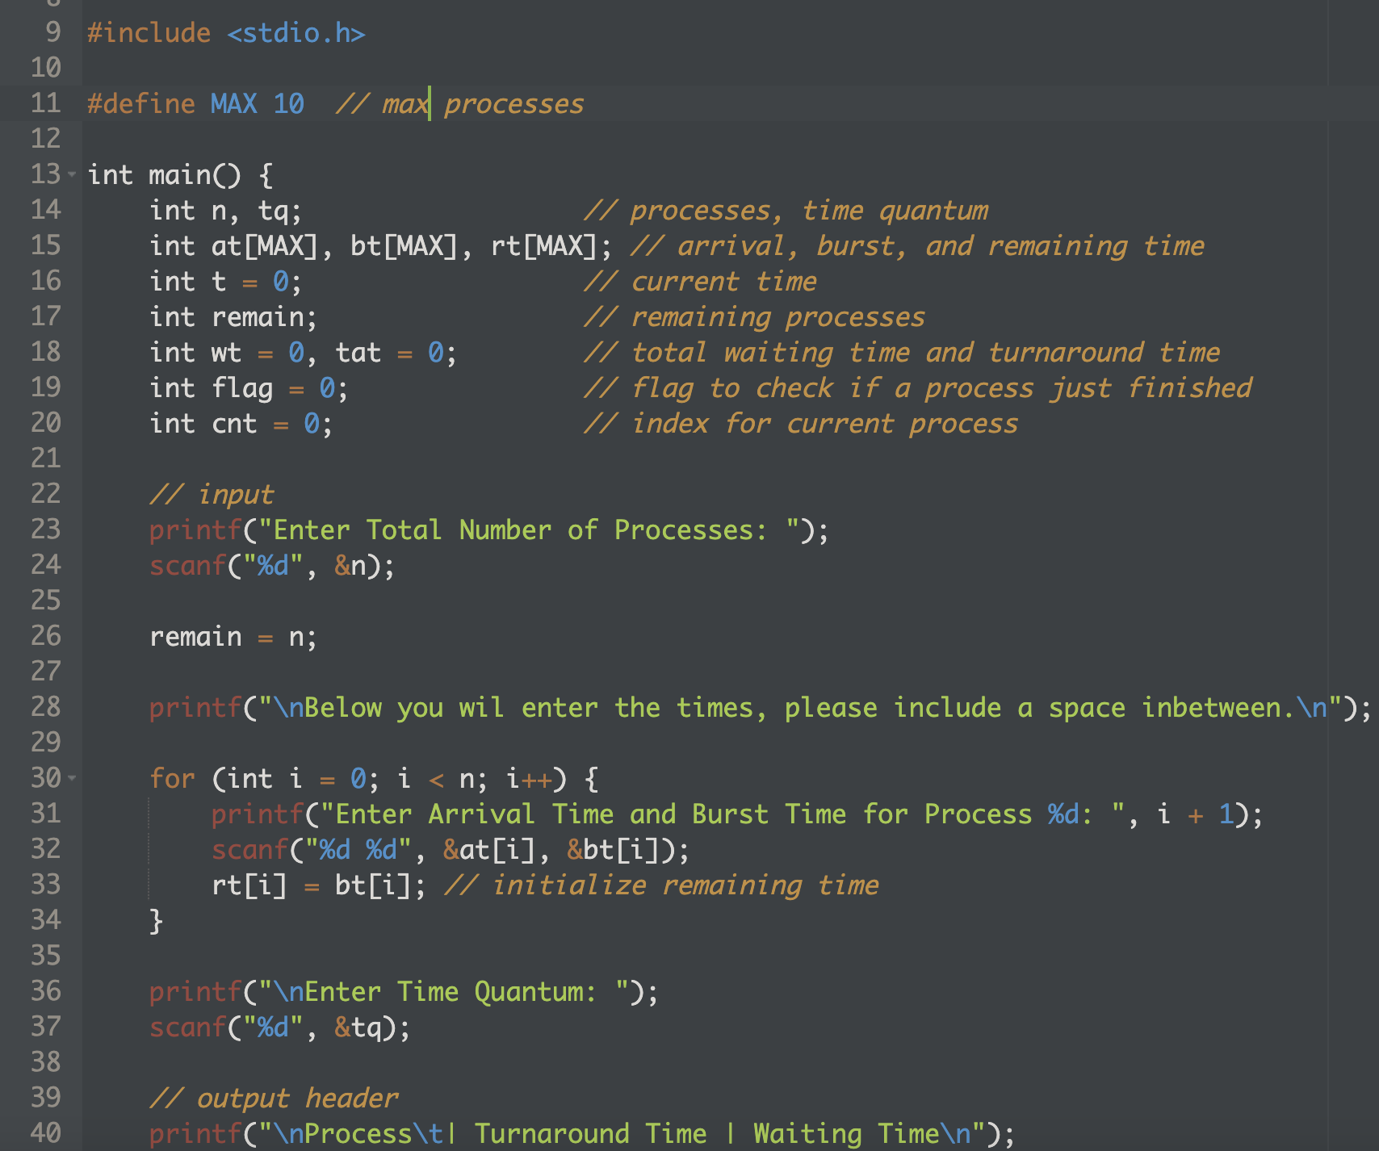
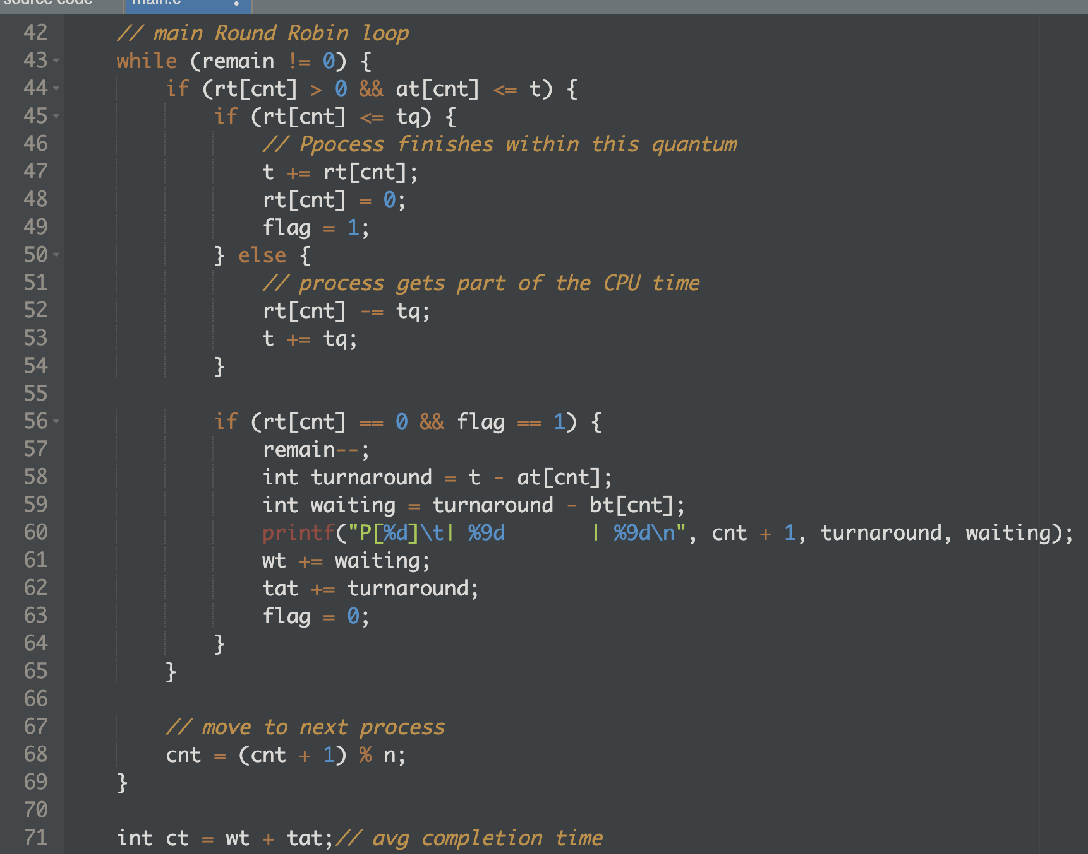
Code

Slide 10
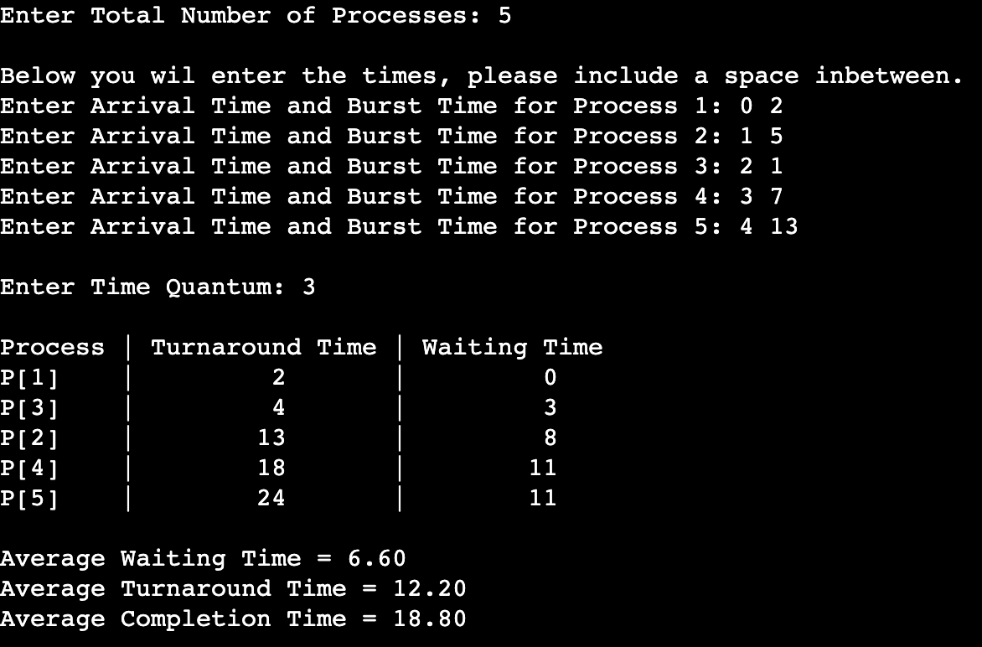
Output

Slide 11
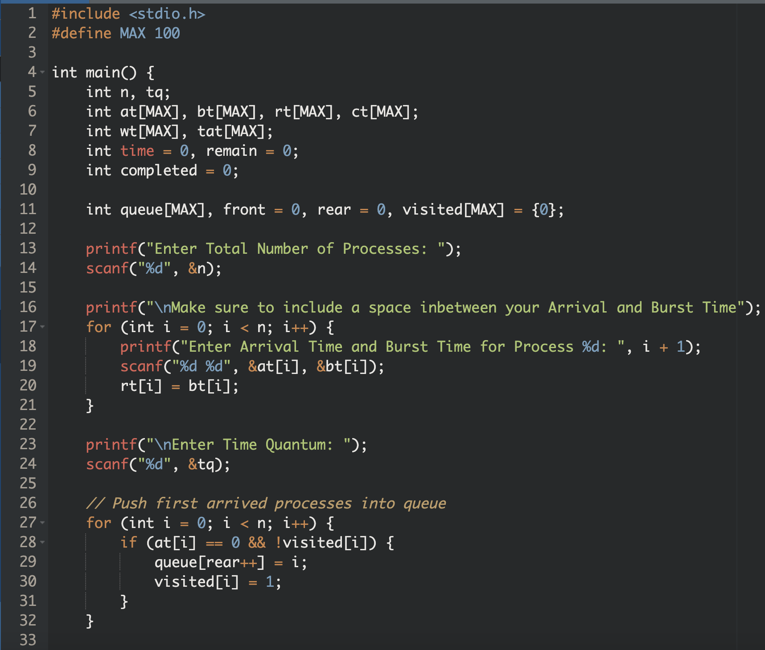
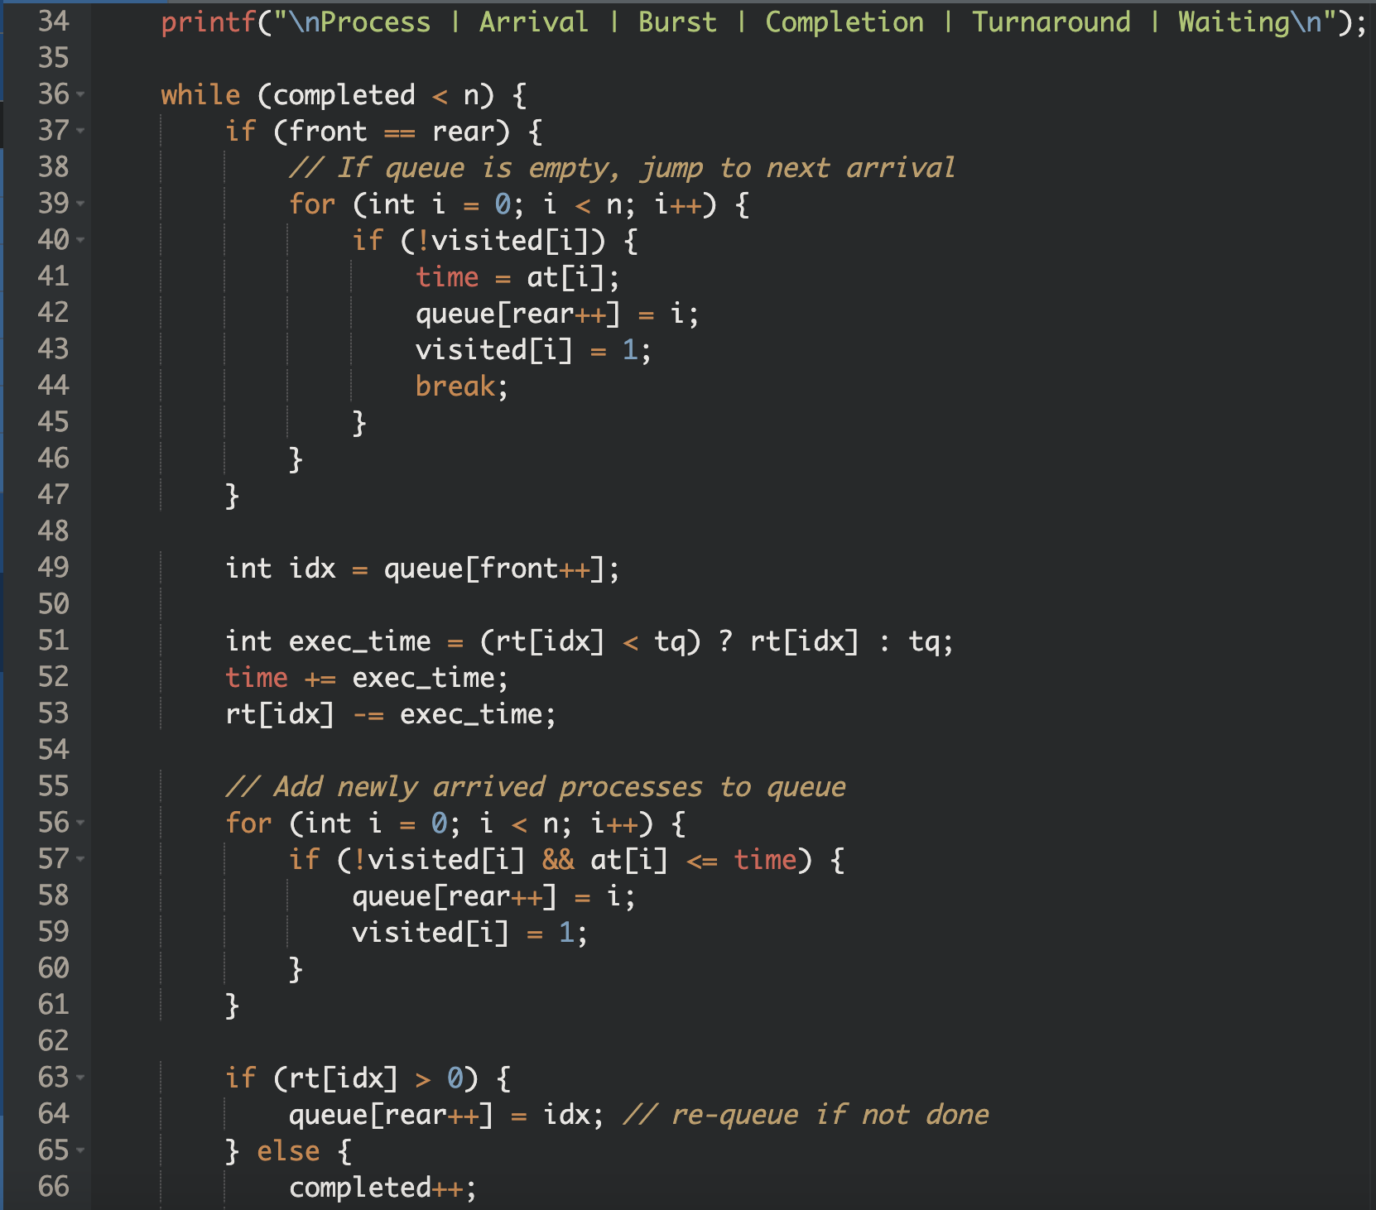
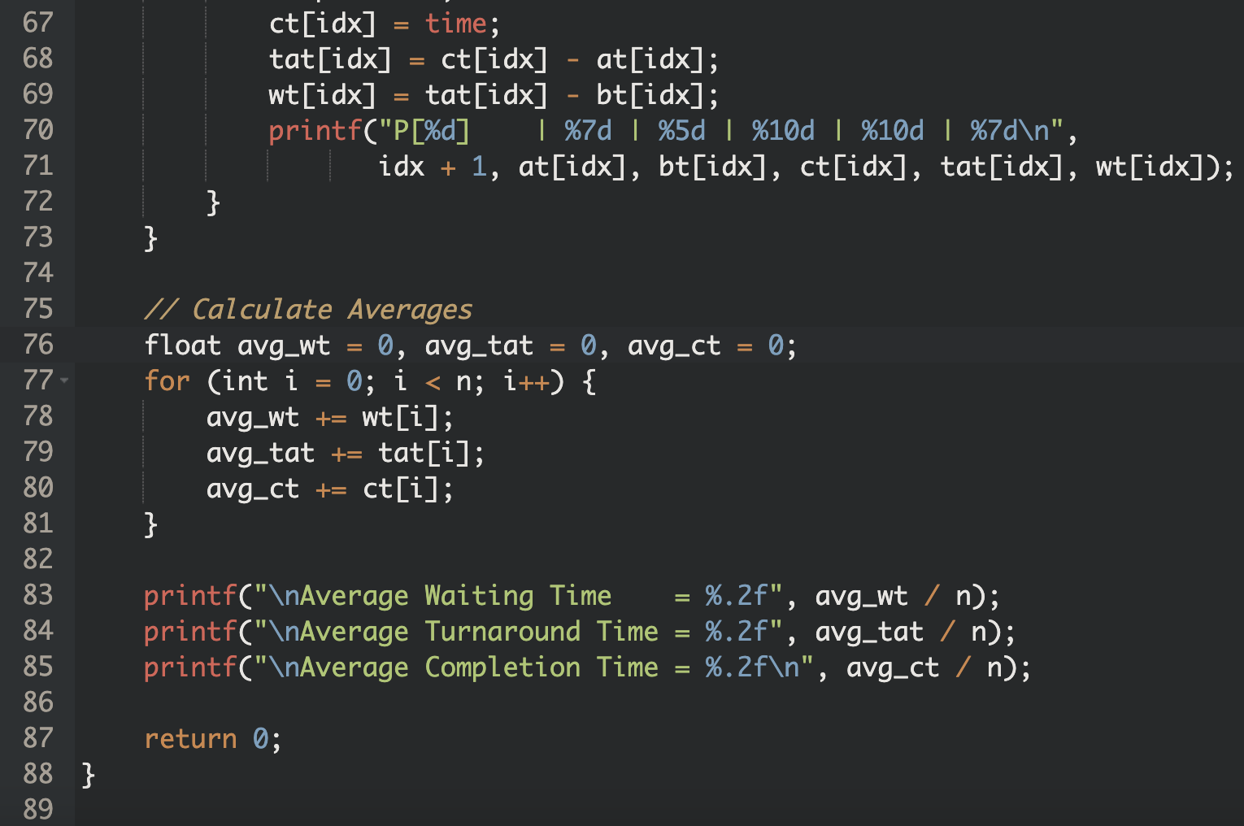
Code Optimization

Slide 12
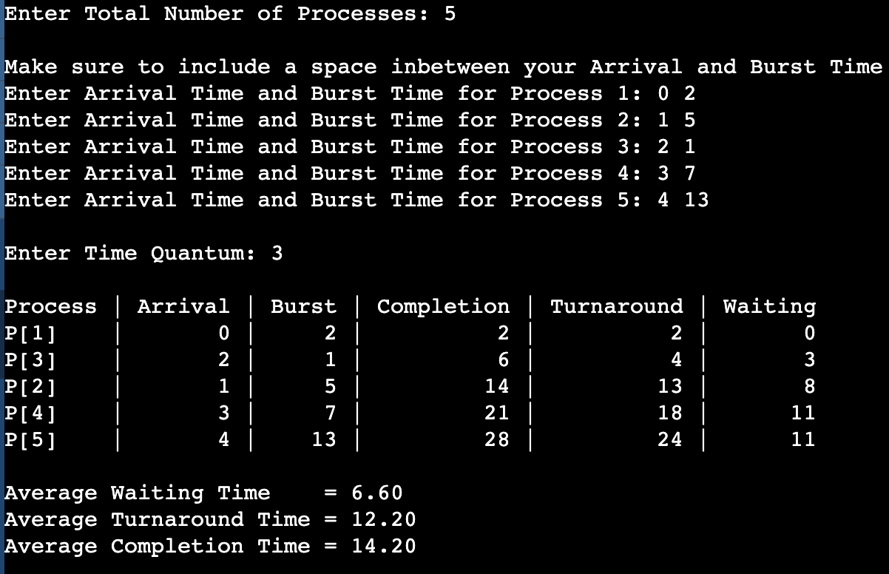
Optimization Version of the Output

Slide 13
Timings
Arrival Times:
Average Waiting Time:
Burst Times:
Average Turnaround Time:
Average Completion Time:
0, 1, 2, 3, 4
6.60
Criteria | Winner | Why
Simplicity | Original | Less code, easier for beginners
Accuracy | Optimized | Correct CT, handles idle CPU, avoids early average CT calculation
Efficiency | Optimized | Only active processes are looped
Extensibility | Optimized | Easier to add priorities, Gantt chart, IO burst, etc.
Production-readiness | Optimized | Cleaner scheduling behavior and scalable
2, 5, 1, 7, 13
12.20
18.80/14.20

Slide 14
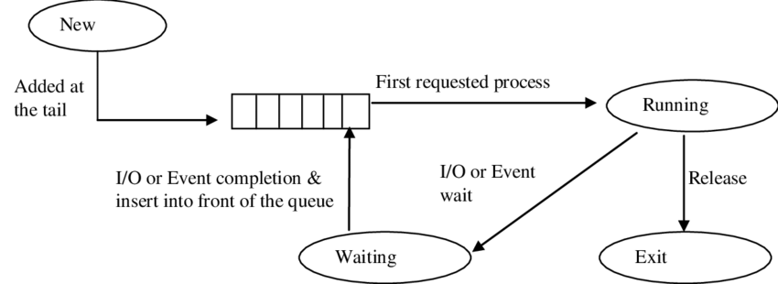
First Come, First Serve
FCFS is the simplest type of CPU scheduling algorithm. In this method, the process that arrives first in the ready queue is executed first. It works just like a queue at a service counter — first in, first out.
Advantages: Easy Implementation, Execution in order they arrive
Disadvantages: Can Cause long waiting times, Convoy Effect(A long process at the front can delay all other processes.)

Slide 15
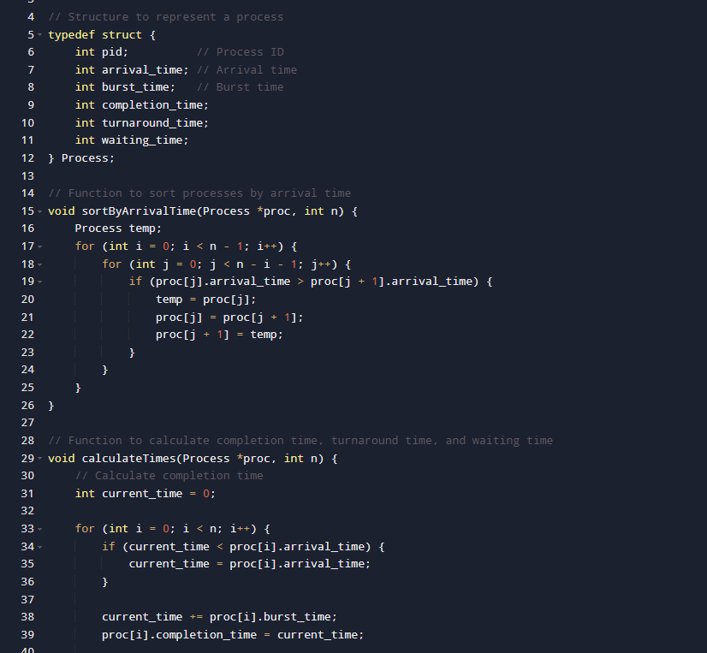
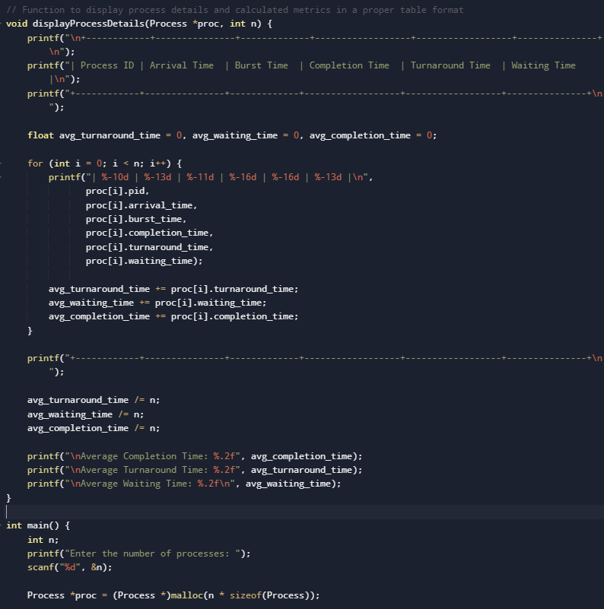
Code

Slide 16
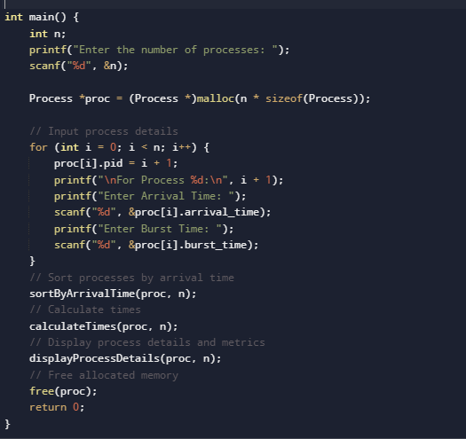
Code

Slide 17
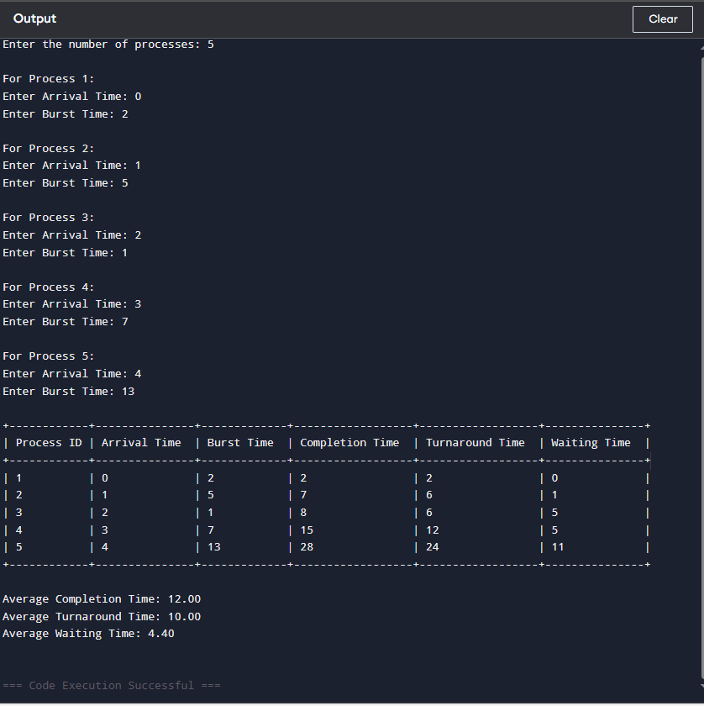
Output

Slide 18
Timings
Arrival Times:
Average Waiting Time:
Burst Times:
Average Turnaround Time:
Average Completion Time:
0, 1, 2, 3, 4
4.40
2, 5, 1, 7, 13
10.00
12.00

Slide 19
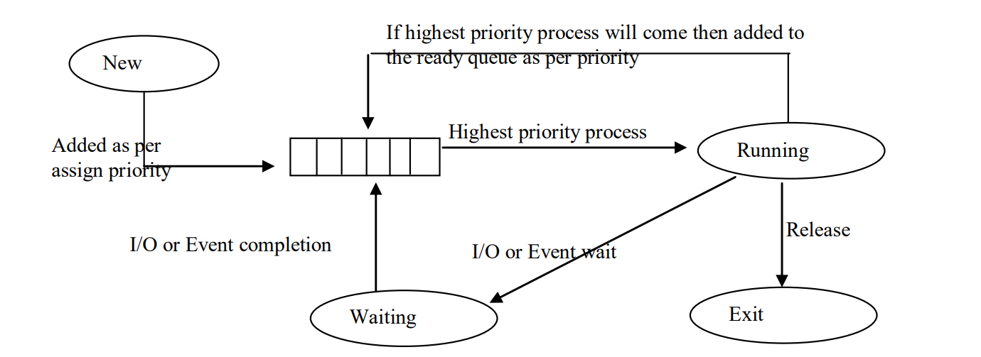
Priority Scheduling

Slide 20
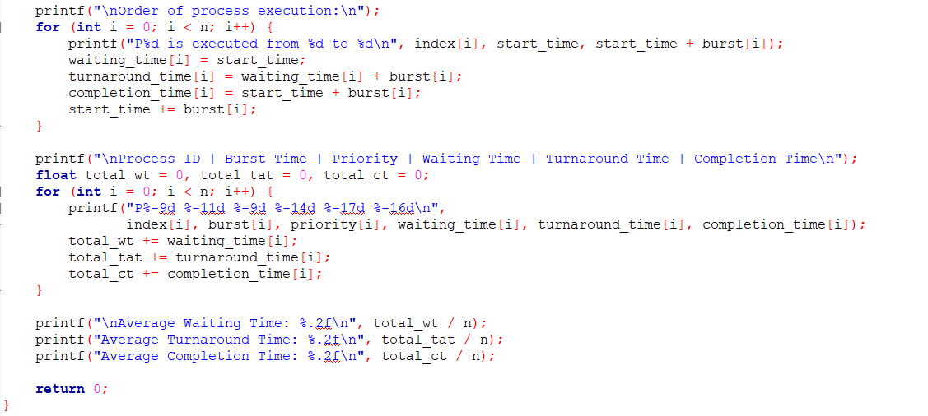
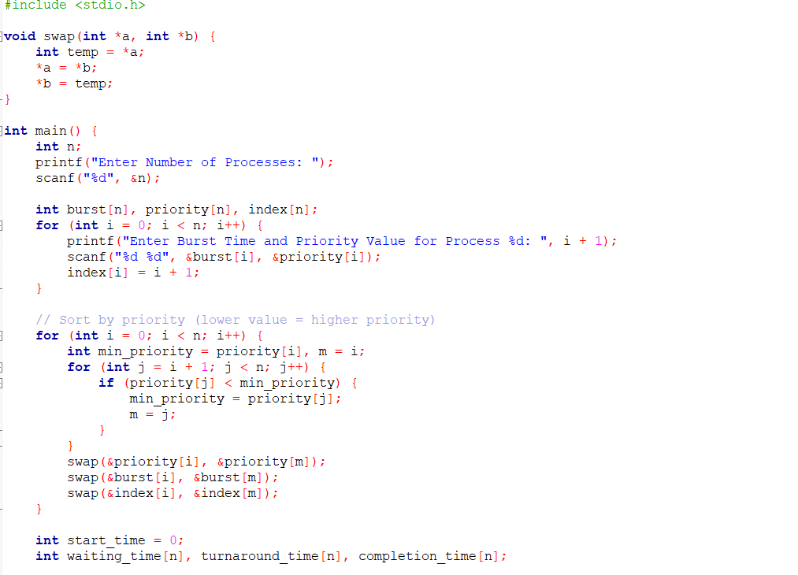

Slide 21
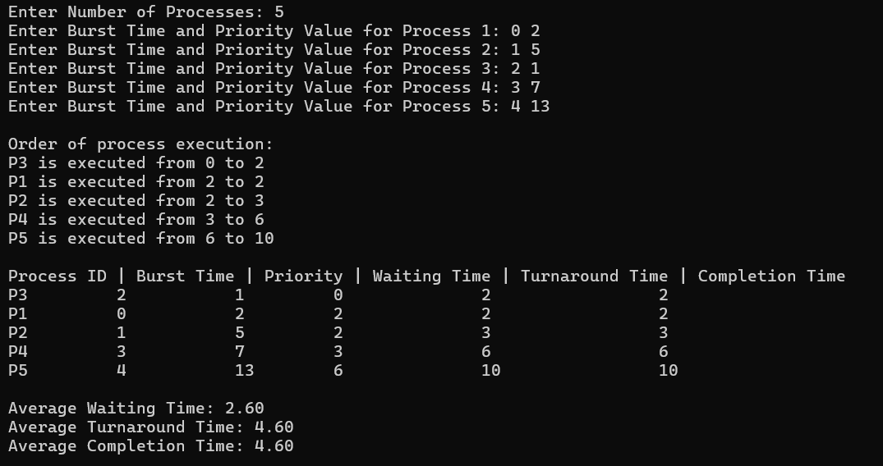

Slide 22
Timings
Arrival Times:
Average Waiting Time:
Burst Times:
Average Turnaround Time:
Average Completion Time:
0, 1, 2, 3, 4
2.60s
2, 5, 1, 7, 13
4.60s
4.60s

Slide 23
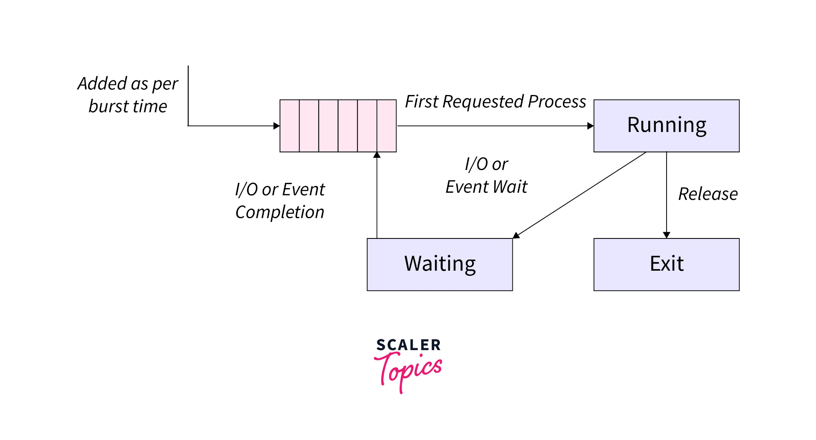
Shortest Job First
The SJF scheduling technique prioritizes the pending process with the shortest execution time (Jeyaprakash and Sambath, 2021).
This method has received considerable recognition as being the most efficient for decreasing the average duration needed to accomplish a task (Hu and Li, 2022). SJF aims to enhance throughput by reducing process waiting times by selecting the shortest available assignment for execution (Pon Pushpa and Devasigamani, 2014).
According to Jeyaprakash and Sambath (2021), the algorithm operates by prioritizing the execution of the process with the shortest duration, regardless of the order in which the processes were received.
Notes:
Reference links:
https://www.scaler.com/topics/sjf-scheduling-in-c/
https://www.sanfoundry.com/c-program-sjf-scheduling/

Slide 24
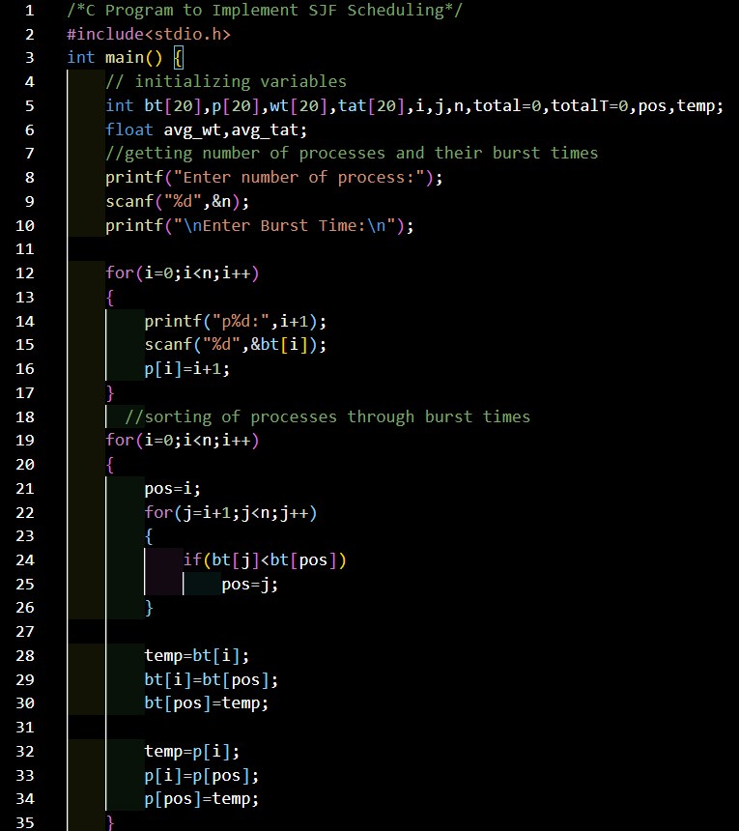
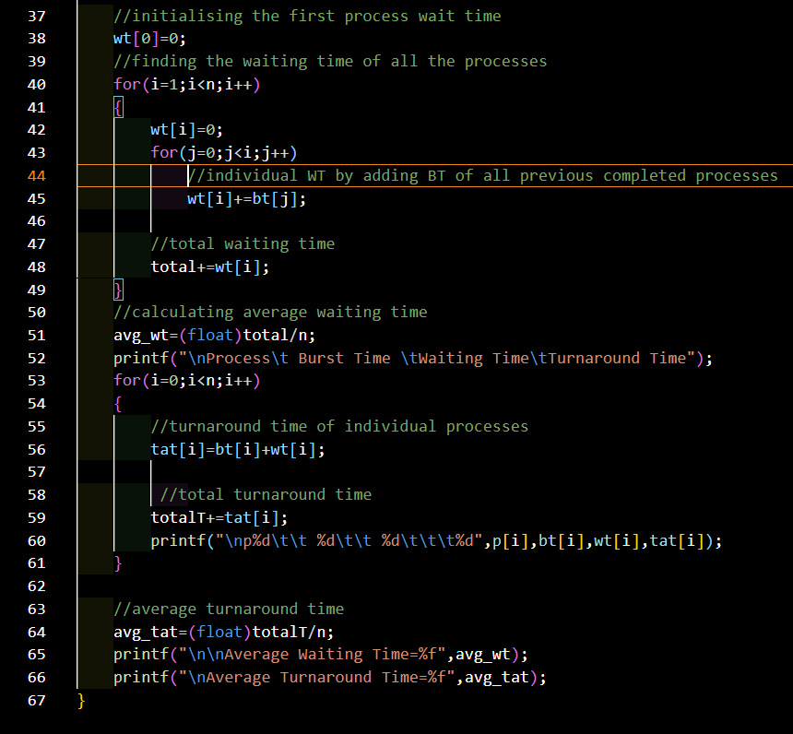
Non-preemptive SJF

Slide 25
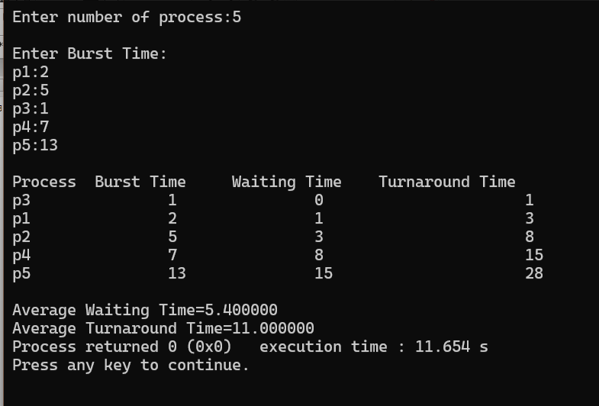
Output
Shravani Kardekar

Slide 26
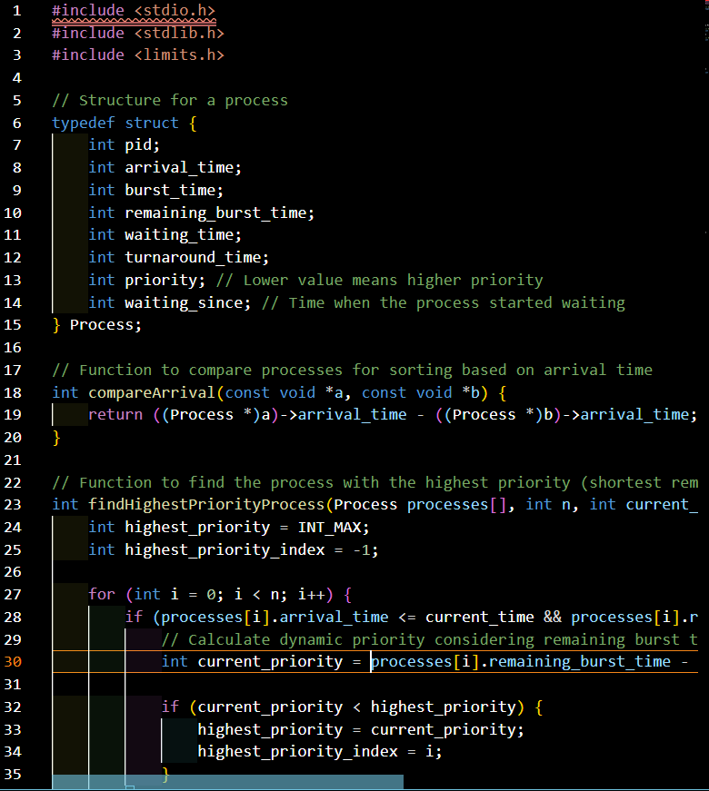
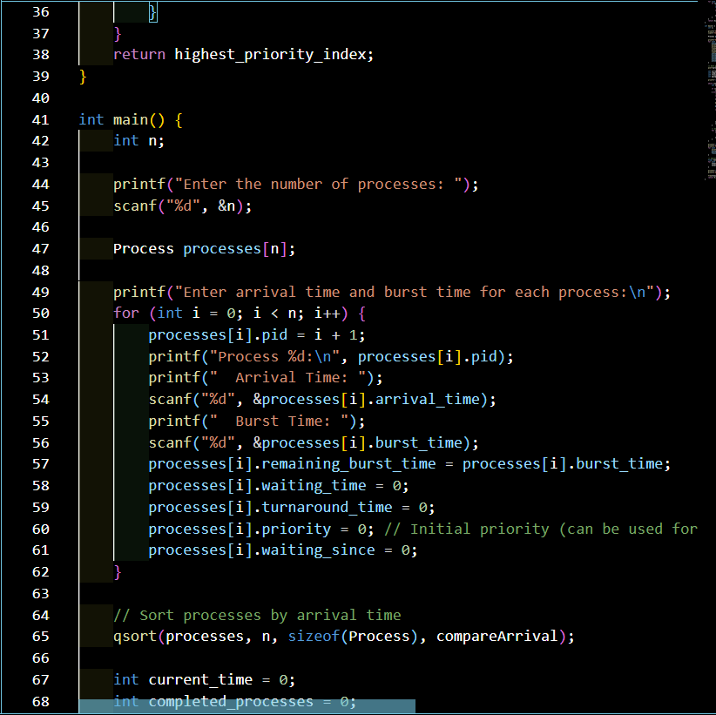
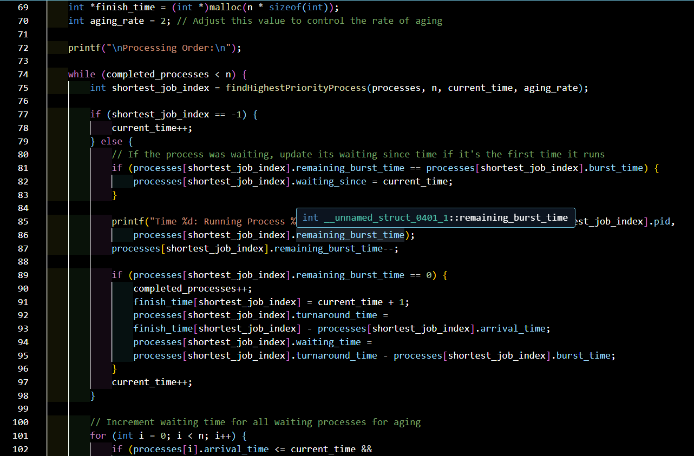
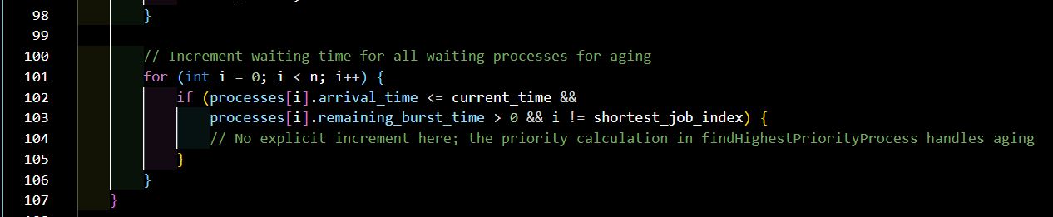
Enhanced Preemptive SJF with Aging

Slide 27
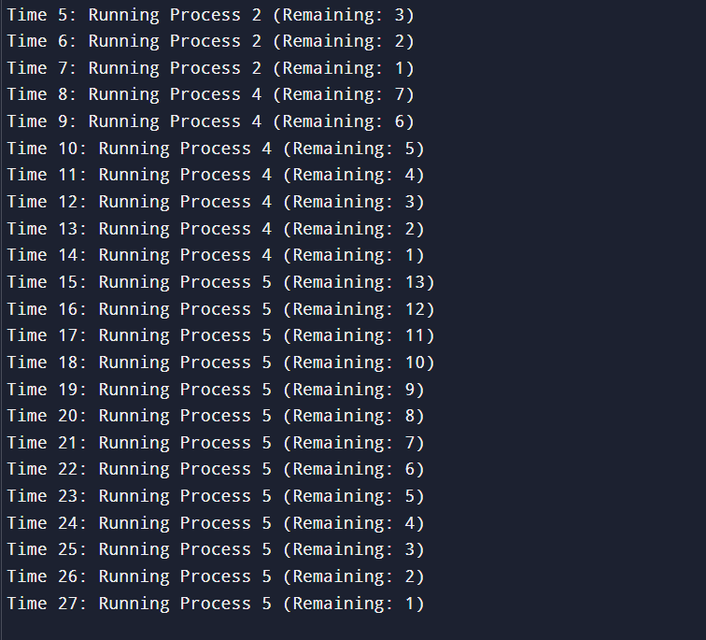
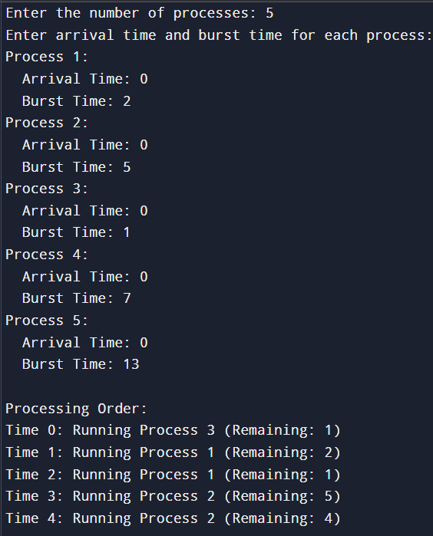
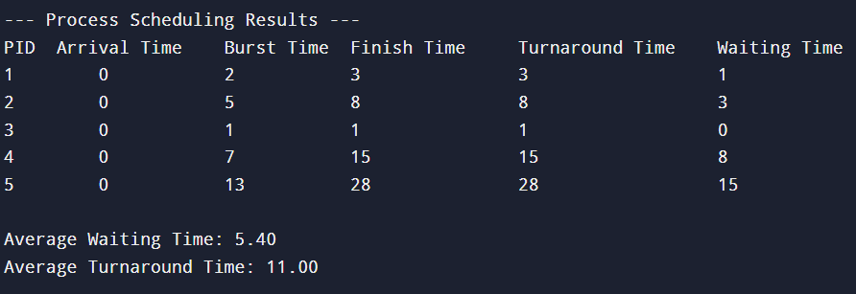
Output

Slide 28
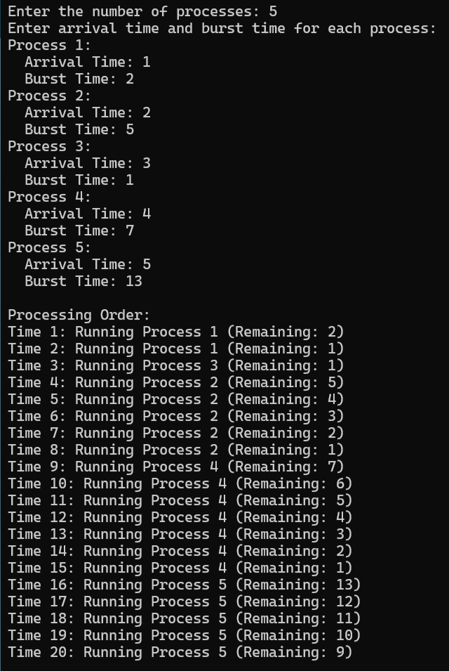
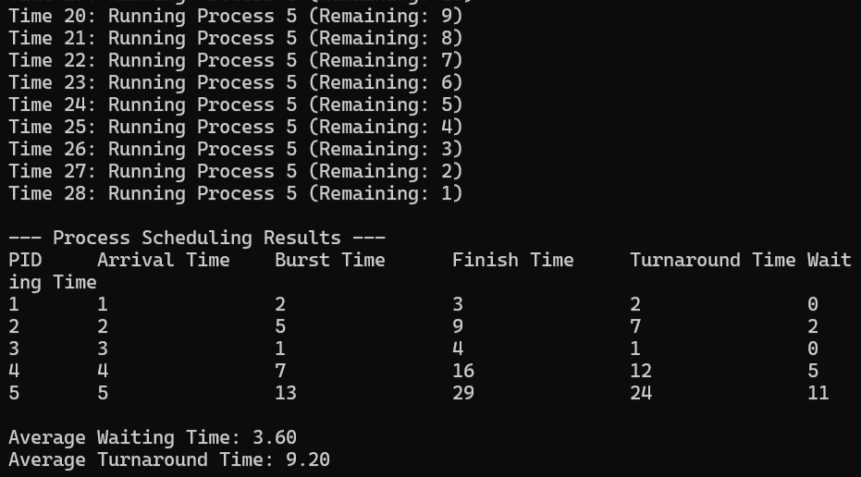
Output with different arrival times:
P1:1, p2:2, p3:3, p4:4, p5:5

Slide 29
Timings
Average Waiting Time:
Arrival Times:
Average Turnaround Time:
Burst Times:
Average Completion Time:
Criteria | Winner | Why
Simplicity | Original | Less code, easier for beginners
Accuracy | Optimized | Enhanced version aims for better accuracy in achieving the goals of fairness and preventing starvation
Efficiency | Original | Lower overhead because there are fewer context switches
Extensibility | Optimized | The priority calculation mechanism can be modified to incorporate other factors beyond just remaining burst time and waiting time
Production-readiness | Optimized | The priority calculation mechanism can be modified to incorporate other factors beyond just remaining burst time and waiting time
5.40/3.6
1, 2, 3, 4, 5
2, 5, 1, 7, 13
11.00/9.2
16.40/12.8

Slide 30
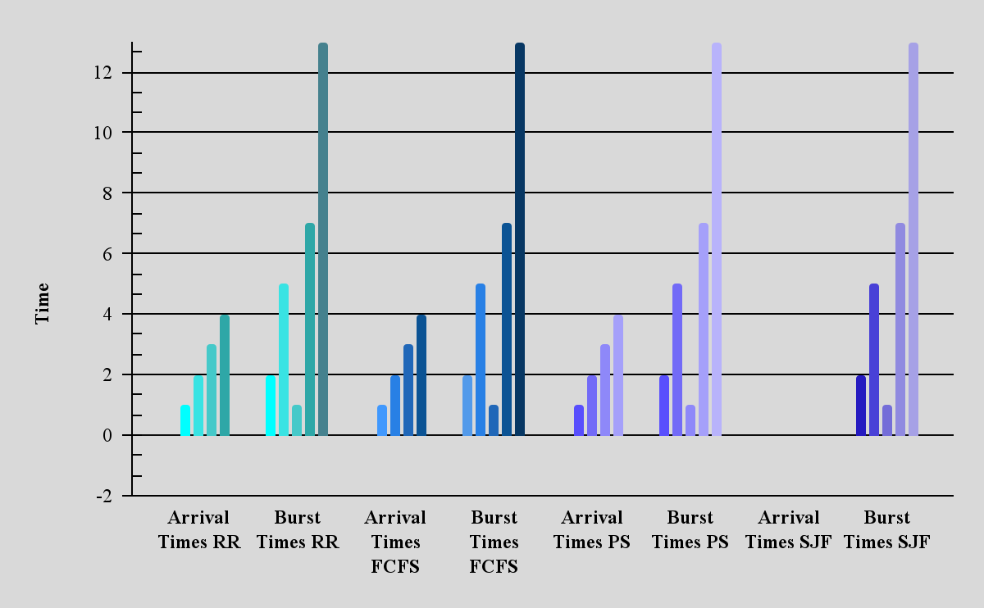
Normal Timings
Arrival Time
RR, FCFS, PS = 0, 1, 2, 3, 4
SJF = 0, 0, 0, 0
*SJF doesn’t need arrival time
Burst Time
RR = 2, 5, 1, 7, 13
FCFS = 2, 5, 1, 7, 13
PS = 2, 5, 1, 7, 13
SJF = 2, 5, 1, 7, 13

Slide 31
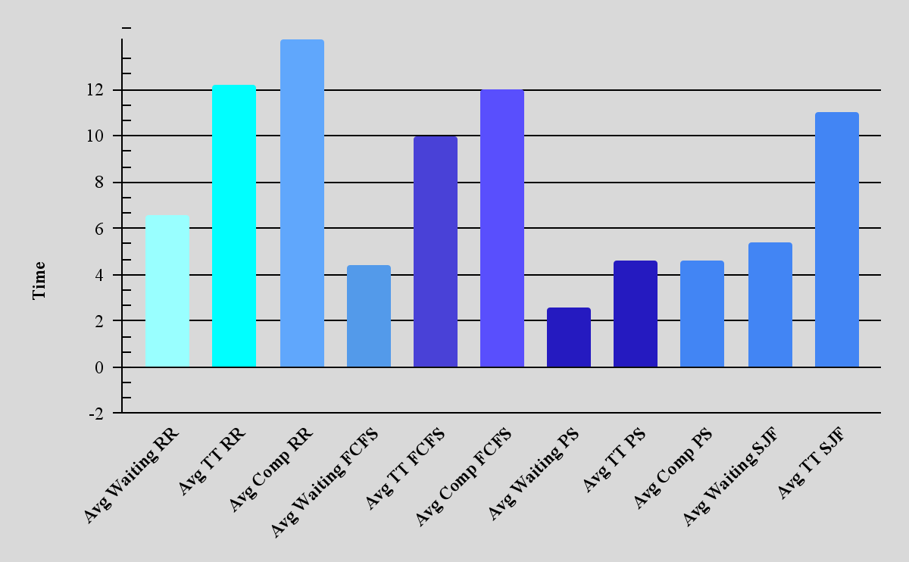
Additional Timings
Waiting Time
RR = 6.60
FCFS = 4.40
PS = 2.60
SJF = 5.40
2.60
Turnaround Time
LRR = 12.20
FCFS = 10.00
PS = 4.60
SJF = 11.00
4.6
Completion Time
LRR = 14.20
FCFS = 12.00
PS = 4.60
SJF = 16.40
4.6

Slide 32
Conclusion
CPU scheduling plays a vital role in optimizing system performance by determining the order in which processes are executed. Each scheduling algorithm—FCFS, SJF, Round Robin, and Priority Scheduling—has its own strengths and trade-offs depending on system goals such as simplicity, fairness, efficiency, or response time.
FCFS is simple but can lead to long wait times.
SJF minimizes average waiting time but may cause starvation.
Round Robin is fair and responsive but has higher context switching.
Priority Scheduling improves efficiency for critical tasks but risks starving lower-priority ones.
Ultimately, the "best" algorithm depends on the specific needs of the system. Understanding the nuances of each helps in selecting the most effective strategy for any given computing environment.

Slide 33
References
Overall:
https://www.academia.edu/126626328/A_Comprehensive_Review_and_Comparative_Analysis_with_Performance_Insights_and_Simulation_Based_Evaluations_of_Innovative_CPU_Scheduling_Algorithms
Round Robin:
https://www.scaler.com/topics/round-robin-scheduling-program-in-c/
First-Come, First-Serve:
FCFS Scheduling
First Come First Serve (FCFS) Scheduling - Scaler Topics
Priority Scheduling:
Priority Scheduling Program in C. Priority Scheduling Program in C | by Mahesh Sharma | Medium
Shortest Job First:
https://doi.org/10.3844/jcssp.2024.972.985
https://www.researchgate.net/publication/341621055_Analysis_of_Preemptive_Shortest_Job_First_SJF_Algorithm_in_CPU_Scheduling

Slide 34

THANKS!
Do you have any questions?

